Slide 1
MAT555E: Statistical Data Analysis for
Computational Sciences Spring24-Presentation: Quantile Regression
Beria ayşenur can
090200705
Istanbul Technical University

Slide 2
Learning Objectives
Quantile Regression
What are Quantiles? Some Definitions
Why Use Quantile Analysis? Advantages of Quantile Regression.
QR Model Specification
QR Objective Function
The differences between linear regression and quantile regression.
The limitations and alternatives of quantile regression models.
References

Slide 3

What are Quantiles?
Quantiles are the inverse of CDF (Cumulative Distribution Function), mathematically they are defined as;
A quantile defines a particular part of data set.
We use quantiles to describe the distribution of dependent variable.
Quantiles and percentiles are synonyms –the 0.99 quantile is 99th percentile.
The best-known quantile is the median. The median is the 0.50 quantile.
Recall that ordinary least squares (OLS) models examine the relationship between the independent variables x and the conditional mean of a dependent variable y.
Remember this interpretation "a percentage change in x causes y to change by %k on average ."
But quantile regression (QR) models examine the relationship between x and the conditional quantiles of y rather than just the conditional mean of y.

Slide 4
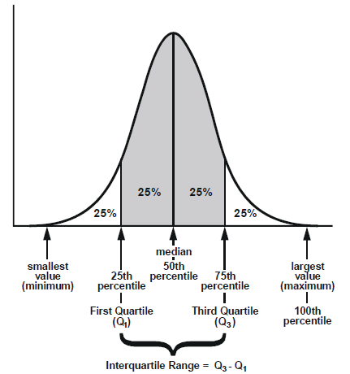
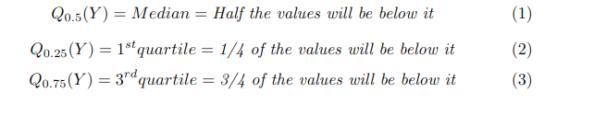
What are Quantiles?
Compared with conventional mean regression, QR can characterize the entire heterogeneous conditional distribution of the outcome variable.​
It may be more robust to outliers and misspecification of error distribution.​
It provides more comprehensive statistical modeling than traditional mean regression.​
​

Slide 5
b. Why Use Quantile Analysis? Advantages of Quantile Regression.
Robustness to Outliers:
Quantile regression reduces the excessive influence of outliers on the predictions. The model is less affected by extreme values in the dataset, leading to more robust and reliable estimates.
Modeling Relationships at Different Points in the Distribution:
Quantile regression can examine relationships at various points in the conditional distribution of the dependent variable.
This provides researchers with the opportunity to explore not only the median (0.5 quantile) but also other quantiles (for example, 0.25 or 0.75).
Handling Heteroscedasticity:
The classical linear regression model (OLS) is based on the assumption that the error terms are homoscedastic (equal variance);
That is, the error terms are expected to have the same variance for the values of all independent variables. However, in real-world data this assumption does not always hold.
Quantile regression lends itself naturally to heteroscedasticity because it estimates a separate regression line for each quantile, and the slope of each line reflects the relationship in that part of the distribution of the independent variable.

Slide 6
b. Why Use Quantile Analysis? Advantages of Quantile Regression.
Focusing on the Tails of the Distribution:
The OLS (Ordinary Least Squares) method focuses on modeling the average relationship between the independent variables and the dependent variable, using all data points.
However, OLS ignores behavior at the extremes of the distribution and cannot capture specific dynamics at these segments.
Quantile regression can examine relationships at these extremes by focusing on a specific quantile (for example, 10%, 90%). This method reveals in detail how the effect of independent variables on the dependent variable may differ in the lower and upper tails of the data distribution. Thus, the heterogeneity in distribution can be better understood.

Slide 7

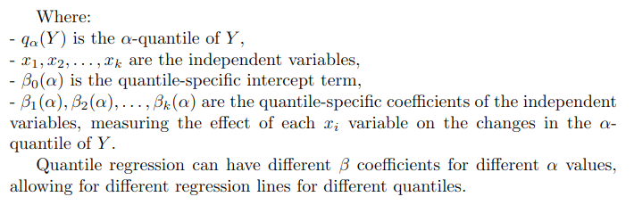
c. QR Model Specification
In quantile regression, we aim to model the relationship between independent variables and the dependent variable at a specific α quantile.
The general formula is as follows:

Slide 8
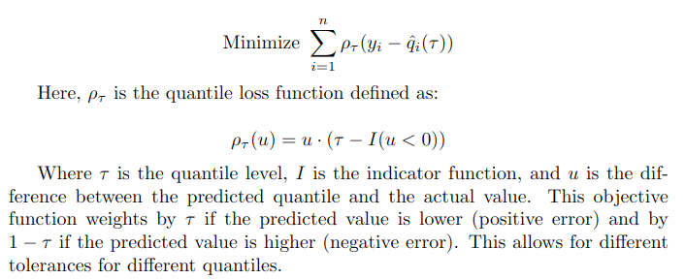
d. QR Objective Function
In quantile regression, the objective function used is the quantile loss function.
The quantile loss function is different from the squared loss function used in OLS regression.
The quantile loss function is used to calculate the total loss by specifically weighing the differences between the quantile values predicted by the regression model at each point and the actual values:

Slide 9
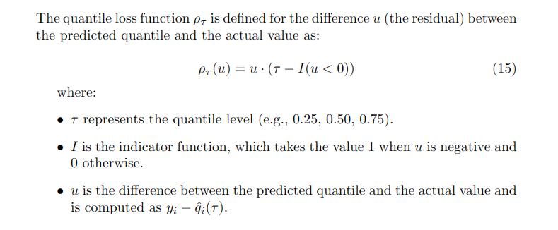
d. QR Objective Function

Slide 10
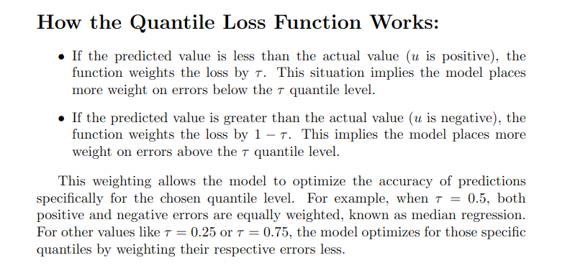
d. QR Objective Function

Slide 11
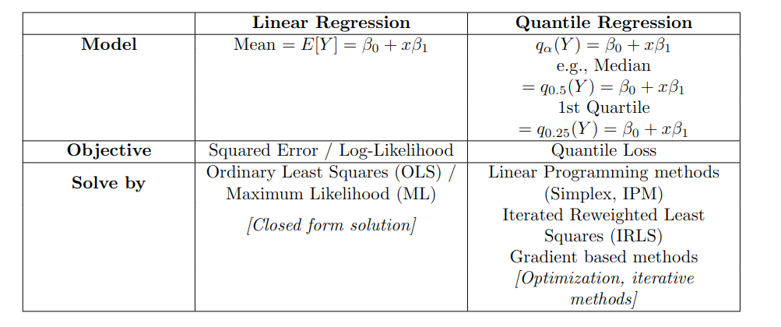
e. The differences between linear regression and quantile regression.

Slide 12
f. The advantages and limitations of quantile regression models.
Limitations of Quantile Regression:
The computation of quantile regression can be more complex and time-consuming than OLS, especially for large datasets, because it typically requires linear programming to solve.
The coefficients in quantile regression can be more difficult to interpret than OLS coefficients, particularly in the presence of heterogeneous effects.
Standard errors and confidence intervals for quantile regression are not as straightforward to compute as in OLS. While bootstrap methods can be used, they add computational burden.
Ideally, quantile regression lines for different quantiles should not cross each other; however, the basic quantile regression algorithm does not guarantee this. Advanced methods are required to enforce non-crossing conditions.
Quantile regression, particularly for extreme quantiles, may not perform well for extrapolation outside the range of the data.

Slide 13
f. The advantages and limitations of quantile regression models.
Alternatives to Quantile Regression:
Robust Regression:
To mitigate the influence of outliers, robust regression methods such as M-estimators can be employed. These methods provide more reliable estimates by reducing the excessive influence of outliers. If a dataset contains a substantial number of outliers that are suspected to distort the predictions of the regression model, robust regression may be the method of choice.
Transformation Models:
When the dependent variable or error terms do not follow a normal distribution, applying an appropriate transformation (log, square root, etc.) before employing OLS can be effective. This approach helps to meet OLS assumptions such as homoscedasticity and normal distribution of error terms. Transformations can enhance the interpretability and statistical properties of the model.

Slide 14
References:
https://scikit-learn.org/stable/auto_examples/linear_model/plot_quantile_regression.html
https://www.statsmodels.org/devel/examples/notebooks/generated/quantile_regression.html
Gilchrist, W. (2000). Statistical Modelling with Quantile Functions. ISBN 1-58488-174-7.
https://sites.google.com/site/econometricsacademy/econometrics-models/quantile-regression

